Slide 1
Discover Flash Player Zero-day Attacks In The Wild From Big Data
Peter Pi
@heisecode

Slide 2
Agenda
Who am I
Background
Discover flash 0-day attacks from big set samples
Vector Length mitigation

Slide 3

About me
Security researcher
APT product developer
Interested in discovering vulnerabilities and writing exploit.
Focus on Flash and Android recently.

Slide 4


WAR3 & Ping Pong Hobbyist

Slide 5
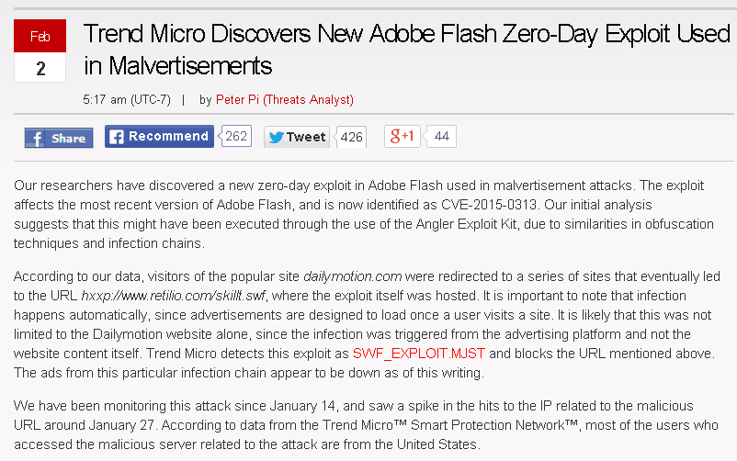
Found CVE-2015-0313 flash 0-day attack

Slide 6

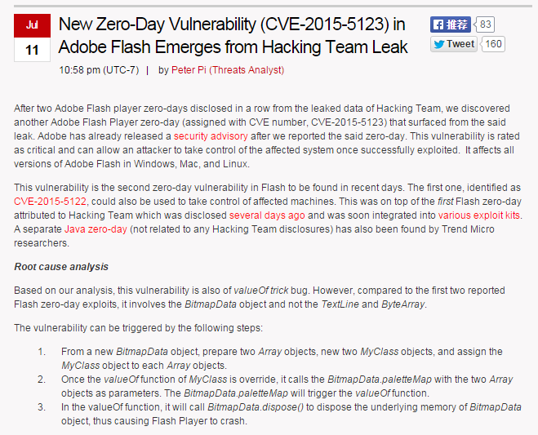
CVE-2015-5122 & 5123 from hacked team

Slide 7
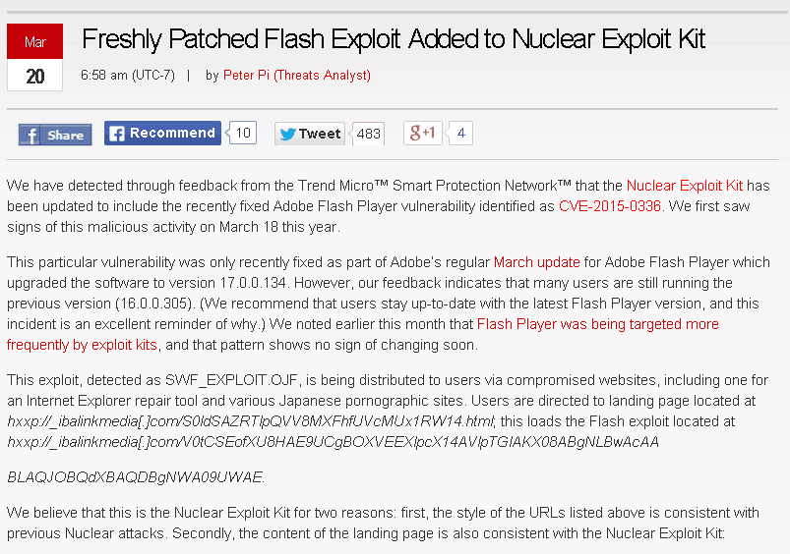
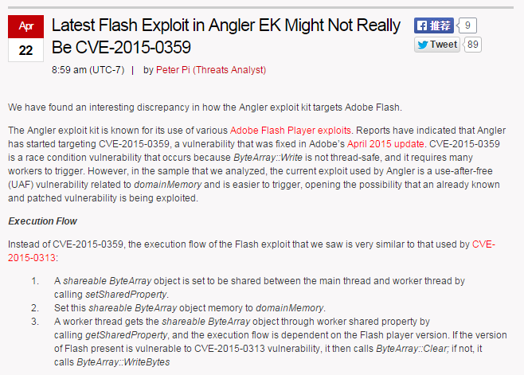
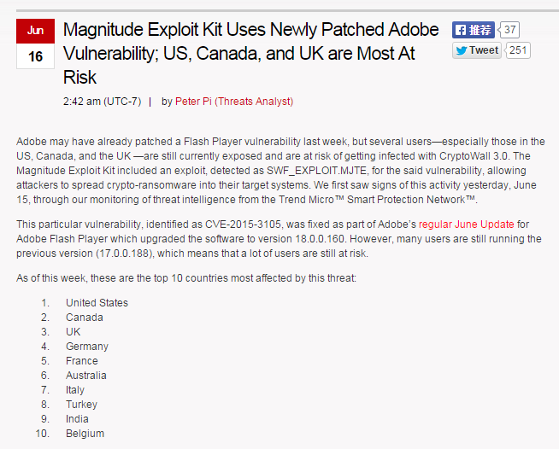
Found some newly patched flash attack

Slide 8
My Blog address
http://blog.trendmicro.com/trendlabs-security-intelligence/author/peterpi/
Will publish some Android bugs I found.

Slide 9
Agenda
Who am I
Background
Discover flash 0-day attacks from big set samples
Vector Length mitigation

Slide 10
Flash Year
Because of browsers’ UAF mitigations and JAVA pop-up window, Flash Player became the weakest out of popular targets in PC.

Slide 11
Flash Year
Finally, we can see that Zero-day attacks’ targets are mostly Flash Player in 2015
> CVE-2015-0310
> CVE-2015-0311
> CVE-2015-0313
> CVE-2015-3043
> CVE-2015-3113
> CVE-2015-5119
> CVE-2015-5122

Slide 12
Flash Year
Newly patched N-day attacks in Exploit Kits this year almost are based on Flash Player vulnerabilities.
> CVE-2014-8439
> CVE-2014-9163 & CVE-2014-9162
> CVE-2015-0336
> CVE-2015-0359
> CVE-2015-3090
….
….

Slide 13
Flash Year
In this situation, I wanted to disclose Flash 0-day attacks when tried to guess future perspective in late 2014.
Disclose newly patched n-day attacks also has value to users.

Slide 14
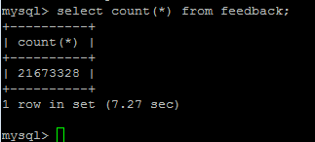
Background
Got tens of millions of suspicious SWFs in our Hadoop server, and thousands newly added every day.
I think this is a good resource to find 0-day attacks
So, this topic title’s big data is a trick, and not related to data mining or machine learning ☺

Slide 15
Agenda
Who am I
Background
Discover flash 0-day attacks from big set samples
Vector Length mitigation

Slide 16
Problem I face
Big set samples to handle.
I need a automation process.
It can achieve very low False Alert rate, fast processing speed.
Final manual check only needs handle little Flash samples.

Slide 17
Need a tool
I need a tool to help me identify a SWF file can exploit target version of Flash Player.
> This tool must have very low False Alert.
> This tool must have logger for improving automation.
> This tool must can record exploit event when detect.
> This tool must can stop the exploit.

Slide 18
FlashExploitDetector(FED)
FED is an IE BHO written by C++
Dynamic hook Flash OCX when Flash Player loaded to IE tab process.
Hook IE event to get current URL name.
Write log to file when detect, it will save the time and the SWF/URL name.
Infinite loop when detect exploit, waiting for automation process to kill IE and continue next SWF file.

Slide 19
Automation Process
Simple Python code.
Register FED BHO using regsvr32.exe
Every time load a HTML contains SWF in IE
FED will hook Flash Player OCX to detect exploit
Kill IE processes to load next SWF file in new IE
When finished all SWF files, parse log file and get the detected SWF files.

Slide 20
Key Point
How to achieve extremely low False Alert rate? There are match points in the flow of exploit.
1. Match vulnerability triggers? This means one vulnerability one rule, no use here, discard
2. Match Vector Heap Spray? This is good, but FA is still high for this special problem, for example old samples will trigger vector heap spray also. And 0-day may no need heap spray(CVE-2015-5119)
3. Match ROP and Shellcode execution stage? It is like EMET. But EMET is hard to automation, can’t record the file name, 0-day may bypass EMET. And implement your EMET with a logger is big effort.

Slide 21
Key Point
In 2014 and 2015, Flash Exploits are all use corrupt Vector to achieve arbitrary read and write memory.
By achieved arbitrary read and write, exploits can bypass DEP, ALSR, CFG and even EMET.
The corrupt Vector need huge length for reading and writing big memory address space of the process.
May be I can match this generic point.

Slide 22
Key Point
Simplified Exploit Flow
VectorAllocate();
VectorSpray();
triggerVulnerability();
findCorruptVector();
buildRopAndShellCode();
execRopAndShellCode();

Slide 23
Key Point
Ideally
vectorAllocate();
triggerVulnerability();
findCorruptVector();
CheckVectorLen();
buildRopAndShellCode ();
LogAndStopExploit();
execRopAndShellCode();

Slide 24
How to implement?
Because before AS3 methods been called, it will be JITed, So I hook the JIT flow of AVM2
When hit the hook point, I can check the AS3 Vector status change between previous hit and this hit.
So, this is likely check whether previous AS3 method has corrupt an AS3 Vector

Slide 25
How to implement it?
Background knowledge
> AVM2 will JIT AS3 methods for performance.
> AVM2’s verifier will check security when doing JIT
> After JIT, the emitted machine code address will be saved in a struct named MethodInfo.
> MethodInfo also saves a method id, uses method id we can get AS3 method name.

Slide 26
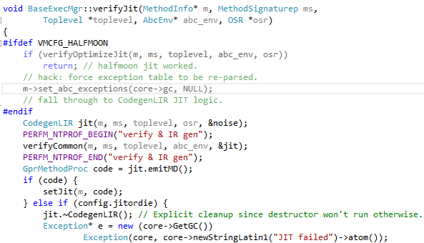
How to implement it?
Key function
> In AVM2(https://github.com/adobe-flash/avmplus), BaseExecMgr::verifyJit is the function to verify and emit code.

Slide 27
How to implement it?
After hooked the JIT flow, we have chance to check the vector status in our JIT_HOOK function
This means we can check vector has been corrupted or not after previous AS3 methods has been executed.

Slide 28
How to implement?
So, Practically
vectorAllocate();
triggerVulnerability();
findCorruptVector();
JIT_HOOK();
CheckVectorLen();
buildRopAndShellCode ();
execRopAndShellCode();

Slide 29
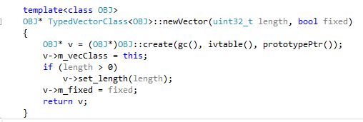
How to check vector length?
Hook Vector Creating
1. Flash Player has 4 types AS3 Vector object.
2. Vector.<int>, Vector.<uint>, Vector.<Number> and Vector.<Object>.
3. I hook Vector.<int> and Vector.<uint> object create function.
4. In AVMplus source code, we can see the create function is a template function. Means that there are 4 instances in flash binary.

Slide 30
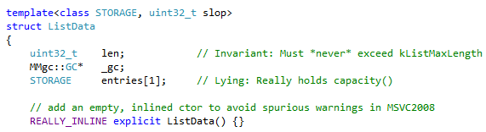
How to check vector length?
Check Vector length
> When there is a vector object created, I will save the vector object address.
> vector_obj_addr + 0x18 is the data list which save vector data.
> First 4 bytes of data list is the vector length.
> So, poi(poi(vector_obj_addr + 0x18) ) is vector length

Slide 31
How to implement?
So, Practically
vectorAllocate();
SaveVectorObj();
triggerVulnerability();
findCorruptVector();
JIT_HOOK();
CheckVectorLen();
buildRopAndShellCode ();
execRopAndShellCode();

Slide 32
Hook Version
Hook Version
> Some sample check Flash Player version, if version is too high or too low, it will terminate execution.
> So I change Flash Player version string in memory
> For example, change WIN 18,0,0,160 to WIN 16,0,0,160
> Just search WIN x,0,0,x in OCX image memory

Slide 33
How to Hook Flash OCX load?
Need to hook Flash OCX when it being loaded first time.
Like Windbg’s module load event
Flash OCX in IE is a COM component.
Hook COM component create in IE, check CLSID of Flash OCX

Slide 34
How to Hook Flash OCX load?
Hook CoGetClassObject function in urlmon.dll
IAT hook
In Hook_CoGetClassObject function, use IsEqualCLSID(rclsid, CLSID_Flash) to identify Flash component is being loaded.
Find Flash OCX module base address and module size, search binary sequence to hook JIT, hook vector create, hook version

Slide 35
OK, Just Run it
DEMO
CVE-2015-5119

Slide 36
Manual Check
FED finally gives me little samples for manual checking.
I need to debug this samples to confirm it is an 0-day or for getting root cause of the 0-day.

Slide 37
Debugging Hard Point
No symbol of Flash Player.
All AS3 methods are JITed. Address is dynamic.
Flash player has script execution time out.

Slide 38
DbgFlashVul
So I wrote a tool to help debug.
A windbg extension named DbgFlashVul written in C++.
It can trace AS3 method.
It can set break point based on AS3 method name.

Slide 39
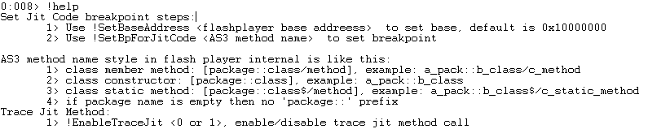
DbgFlashVul
!help

Slide 40
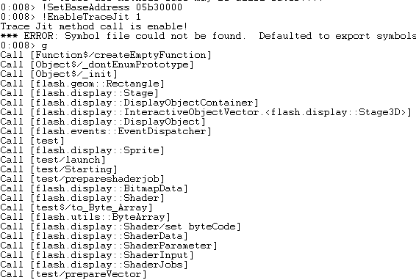
DbgFlashVul
! EnableTraceJit 1

Slide 41
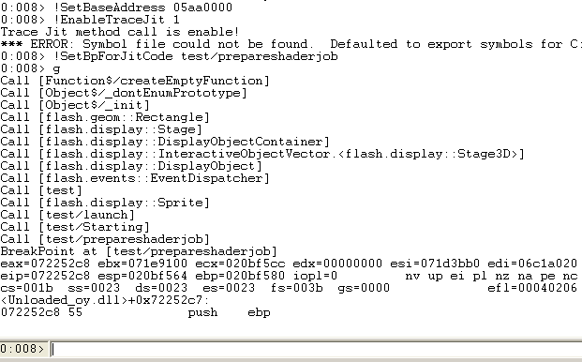
DbgFlashVul
!SetBpForJitCode

Slide 42
A real example : CVE-2015-3090
Used by most exploit kits.
Vulnerability can be simplified like this:
private var myShaderjob:ShaderJob = null;
this.myShaderjob = new ShaderJob(this.myShader);
….
this.myShaderjob.width = 0;
this.myShaderjob.start();
this.myShaderjob.width = 606;
When changing ShaderJob width asynchronously, it will cause memory overwrite.

Slide 43
A real example : CVE-2015-3090
The exploit flow can be simplified like this:
prepareshaderjob();
prepareVector(); // vector spray
attacking(); // trigger vulnerability to overwrite vector length
if ( !findCorruptVector() ) {
return (false);
};
buildRopAndShellcode()
exec();

Slide 44
A real example : CVE-2015-3090
For example, we want to get the ROP gagdets and shellcode used by this exploit.
Uses DbgFlashVul can easily do this.

Slide 45
A real example : CVE-2015-3090
Almost every flash exploit using corrupt vector will have two AS3 functions, like read_memory and write_memory.
The two function use corrupt vector to read and write arbitrary memory.
So, we can use DbgFlashVul to break the execution on write_memory. Exploit uses this function to construct ROP chain and shellcode.

Slide 46
A real example : CVE-2015-3090
Steps:
> Set break point at write_memory
> After break, get the address of “corruptVector[index] = value”, the assembly is like “mov dword ptr [edx+eax*4+8], ecx”
> Set break point on the address.
> When break, every ecx is a part of ROP chain and shellcode

Slide 47
A real example : CVE-2015-3090
0:008> !SetBaseAddress 038f0000
0:008> !SetBpForJitCode test/write_memory
0:008> g
BreakPoint at [test/write_memory]
eax=05072424 ebx=05039100 ecx=020bf4b0 edx=00000002 esi=05023b08 edi=05023b08
eip=05072424 esp=020bf464 ebp=020bf480 iopl=0 nv up ei pl nz na pe nc
cs=001b ss=0023 ds=0023 es=0023 fs=003b gs=0000 efl=00040206
<Unloaded_oy.dll>+0x5072423:
05072424 55 push ebp
0:008> p
……
0:008> p
eax=00089352 ebx=05039100 ecx=03bcbeb6 edx=0510e2c0 esi=05023b08 edi=05023b08
eip=05072553 esp=020bf428 ebp=020bf460 iopl=0 nv up ei ng nz na po cy
cs=001b ss=0023 ds=0023 es=0023 fs=003b gs=0000 efl=00040283
<Unloaded_oy.dll>+0x5072552:
05072553 894c8208 mov dword ptr [edx+eax*4+8],ecx ds:0023:05333010=00000000
0:008> bu 05072553
0:008> g
Breakpoint 4 hit
eax=0008937b ebx=05039100 ecx=03b66ea0 edx=0510e2c0 esi=05023a78 edi=04a6a020
eip=05072553 esp=020bf548 ebp=020bf580 iopl=0 nv up ei ng nz na pe cy
cs=001b ss=0023 ds=0023 es=0023 fs=003b gs=0000 efl=00040287
<Unloaded_oy.dll>+0x5072552:
05072553 894c8208 mov dword ptr [edx+eax*4+8],ecx ds:0023:053330b4=00000000
0:008> u ecx
Flash32_17_0_0_134!DllUnregisterServer+0x92fe4:
03b66ea0 94 xchg eax,esp // stack pivot
03b66ea1 c3 ret

Slide 48
How to implement it?
Get MethodInfo:: getMethodName address by binary searching
Hook BaseExecMgr::verifyJit like FED
In Hook function:
> Get emitted code address and MethodInfo object
> Call MethodInfo:: getMethodName with MethodInfo object(ecx)
> Get AS3 method name from eax
> Save AS3 method name and code address

Slide 49
How to implement it?
void BaseExecMgr::verifyJit (…) {
…
…
jump hook_funck
…
…
}
void hook_func (…) {
name = method_info->getMethodName ();
address = code_address;
Map[name] = address ;
jump verifyJit
}

Slide 50
DbgFlashVul can do other things
Help to write flash player exploit
Help to verify template SWF is correct or not when do fuzzing
Help to dump embedded SWF by setting break point at LoadBytes
……

Slide 51
Agenda
Who am I
Background
Discover flash 0-day attacks from big set samples
Vector Length mitigation

Slide 52
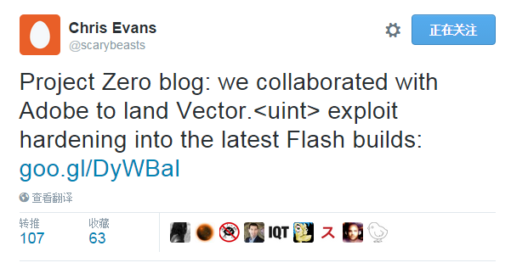
Vector exploit mitigation

Slide 53
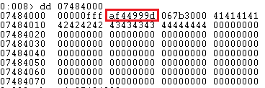

Vector exploit mitigation
Vector length check
> add a length XOR cookie in vector buffer object
| length | cookie | gc relate | data |
> compare when using length, (length ^ seed) == cookie

Slide 54
Vector exploit mitigation
Vector length check bypass
> need a strong info leak bug to read both length and cookie to calculate the seed
> seed = (length ^ cookie)

Slide 55
Vector exploit mitigation
Vector buffer object isolated
> allocate vector object in system heap not in flash gc heap
> makes vector buffer memory hard to occupy the freed memory, mitigate the exploit of UAF bugs
> makes heap buffer overflow bugs hard to overwrite vector buffer object.

Slide 56
Vector exploit mitigation
Vector buffer object isolated bypass
> need to heap spray many vector objects to some address
> need a overwrite bug to overwrite a heap sprayed address

Slide 57
Conclusion
The mitigation makes vector length based exploit hard.
This mitigation doesn’t decrease the number of vulnerabilities of Flash Player.
The mitigation can bypass but need more good bugs
Some one may find replacement for vector

Slide 58
Reference
“Smashing The Heap With Vector,” Haifei Li
“Inside AVM,” Haifei Li
Google Project zero, http://googleprojectzero.blogspot.tw/2015/07/significant-flash-exploit-mitigations_16.html

Slide 59
Special Thanks To
@LambdaTea
> Implemented FED together with me

Slide 60

Thank you!

